Slide 1
OYO Hotels
Prices Project

Slide 2
PROBLEM STATEMENT
This research aim at the cases of all cities in OYO hotel. And to find all the information related to them to calculate the lowest price comparisons & maximum comparisons. Apart from that, it will help us to get a clear picture on its bi-variate and uni-variate options with various graphs and charts.
To achieve such aim, we need to follow certain steps and in the next slides, we can find out the steps acquainted with the process of getting the most suitable solution.

Slide 3

STEP-1
SEARCH FOR
WEBSITES
Searching best website to do the scraping is the most crucial and always the first step to do before doing the extraction. Because, relevant and trusted data are the most crucial data which will give us accurate results in terms of our solution statement and diagrams. In our case, its OYO Hotels. As, it gives the live and relevant hotel information with respect to cities.

Slide 4
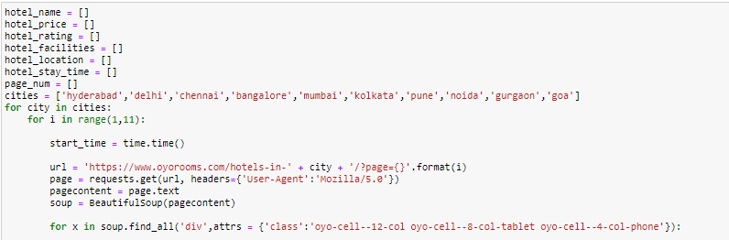
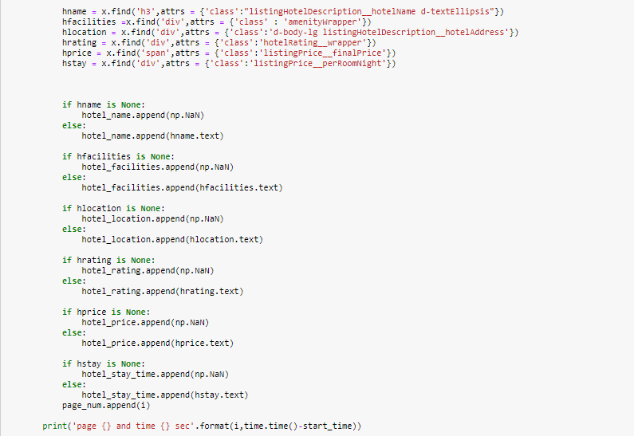
STEP-2
EXTRACT THE DATA
After getting the website, we need to make sure we find out all the DOM elements attached to our required parameters we are trying to extract.
Once the DOM has been found out, we used their ID/class/xpath to get their values from website using python & Beautifulsoap library.
Please find the below code snapshot for better understanding

Slide 5
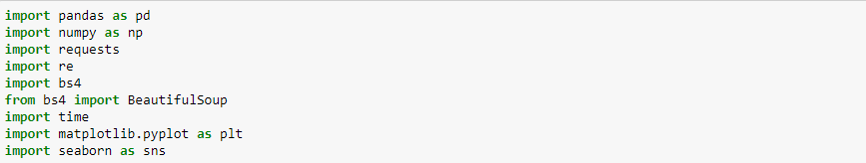
STEP-3
CREATE A DATA FRAME
Pandas Data Frame is a 2-dimensional named information structure with sections of possibly various sorts. It is by and large the most normally utilized pandas object. Pandas Data Frame can be created in multiple ways. Let’s discuss different ways to create a Data Frame one by one.
Please find the below screenshot for Data frame creation.

Slide 6
STEP-4
EXPORT INTO .CSV FORMAT
Once the data is ready and cleaned, we need to export it into .csv file for storing and reutilizing the data. Please find the below screenshot for extraction:

Slide 7
STEP-5
READ & CLEAN CSV FILE
Once the csv file is saved and ready to use, we read the file using Pandas and do all the operations there.
When i Read this Csv File There Are “ 1701 Rows “ and “ 8 Columns “
Then We can see There are some mix data which we need to separate them to collect specific data.
And We can see ‘₹’ This Causing a Problem to convert The data Type Object To Float.
At the end i use ISNULL Function to Drop All of The Null Value.

Slide 8
City
We Can se There are 10 cities ,
Mumbai Has The Maximum Number Of Hotel Prices Compare To Others .
And Hyderabad Has The Minimum Number Of Hotel Prices Compare To Others
You Can See The Graph in Data Visualization , Slide No 5 .

Slide 9
Hotel Price
Here We can See The Minimum Price & Maximum Price Of The All Hotels .
Minimum Price from All Of the Hotel is 461.00 INR .
Maximum Price from All Of the Hotel is 6,775.00 INR .
You Can See The Graph in Data Visualization Down Below Slide No 4.

Slide 10
Rating
Minimum Rating from All Of the Hotel is 0.00
Maximum Rating from All Of the Hotel is 5.00
And There Are some Outlier When I Compare Rating & Price, You Can See The Graph End of the Slide.

Slide 11

DATA
ANALYSIS

Slide 12
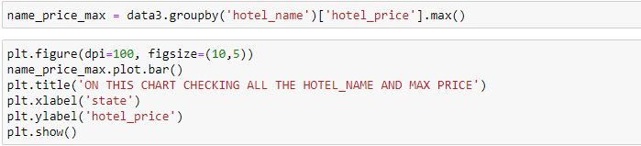
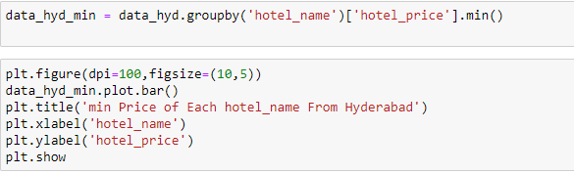
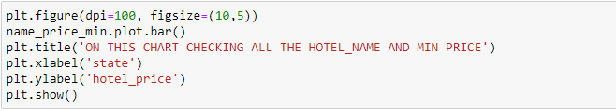
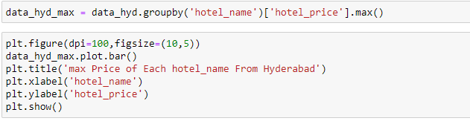
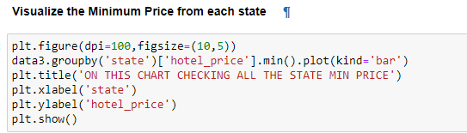
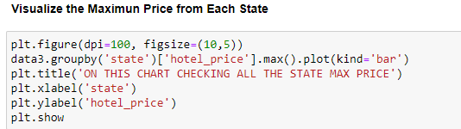
All The hotels Maximum price
Min Price of Each Hotel Name From Hyderabad
All The hotels Minimum price
Max Price of Each Hotel Name From Hyderabad
All The Hotel Prices and Ratings

Slide 13
DATA
VISUALIZATION

Slide 14
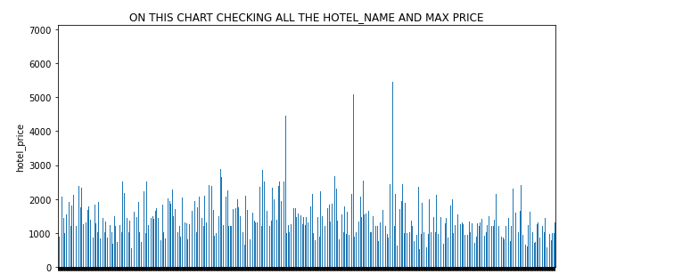
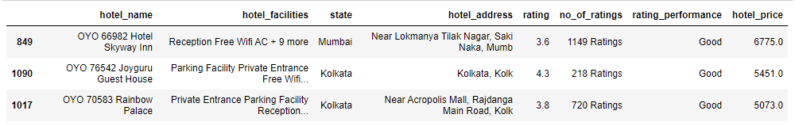
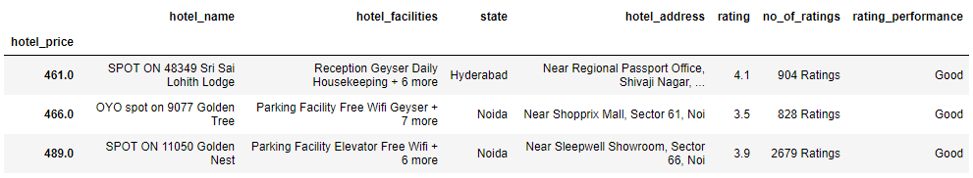
All The hotels Maximum & Minimum price
On This Chart All The hotels Maximum price is 6,775.00 INR or You Can See in The below List
On This Chart All The hotels Minimum price is 461.00 INR or You Can See in The below List

Slide 15
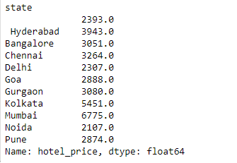
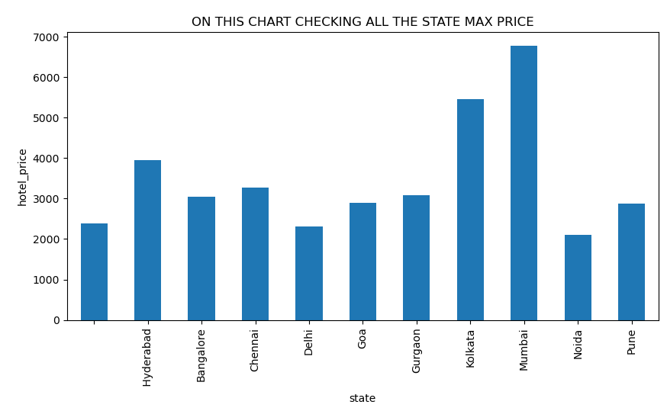
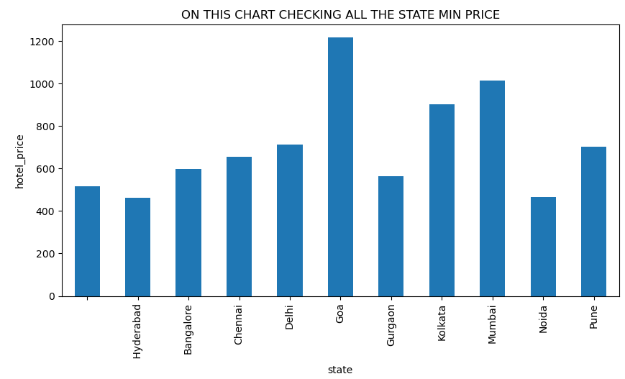
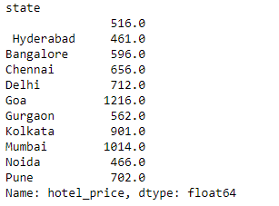
All The cities hotels Maximum & Minimum price
Graphical Bar Chart
On This Chart All The cities hotels Maximum price Citi is Mumbai
On This Chart All The cities hotels Maximum price Citi is Hyderabad

Slide 16
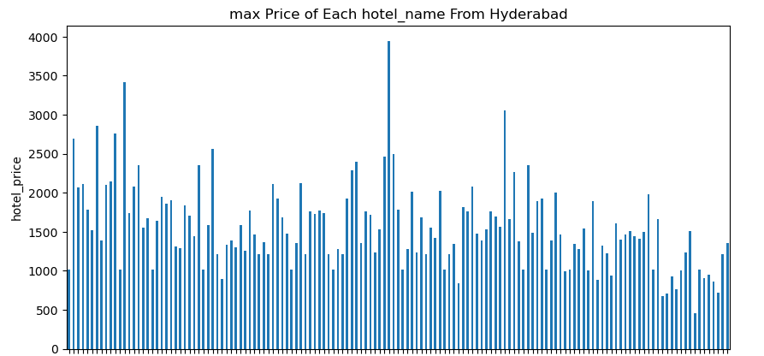
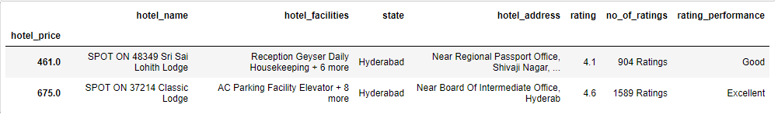
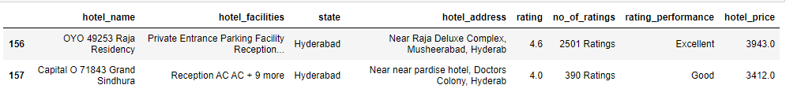
Hyderabad Chart Bar
On This Chart Hyderabad hotels Maximum & Minimum price
100
%
55
%
4
%
%
On This Chart All The hotels Maximum price is 461.00 INR or You Can See in The below List
75
%
On This Chart All The hotels Maximum price is 3,943.00 INR or You Can See in The below List

Slide 17
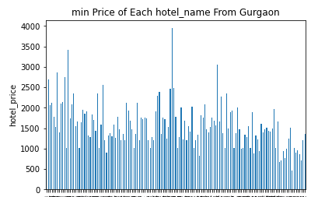
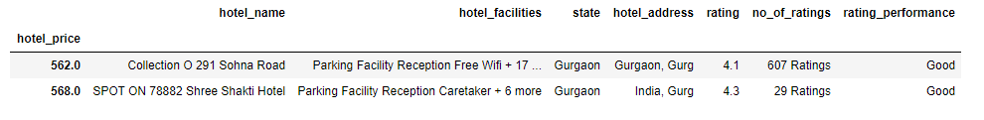
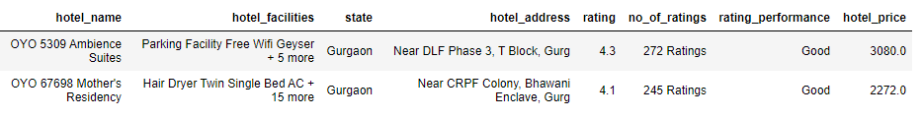
On This Chart Gurgaon hotels Maximum & Minimum price
On This Chart All The hotels Maximum price is 562.00 INR or You Can See in The below List
On This Chart All The hotels Maximum price is 3,080.00 INR or You Can See in The below List

Slide 18
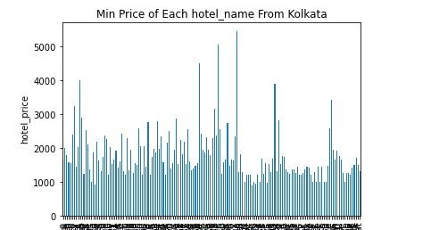
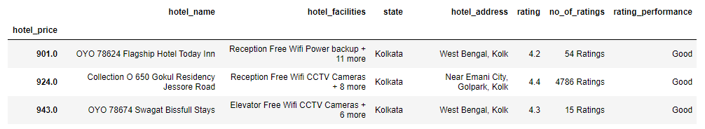
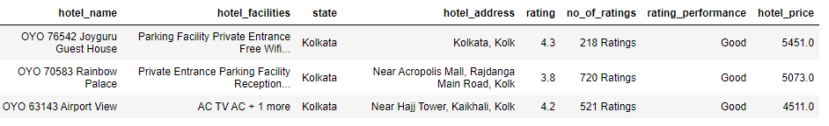
On This Chart Kolkata hotels Maximum & Minimum price
On This Chart All The hotels Minimum price is 901.00 INR or You Can See in The below List
On This Chart All The hotels Maximum price is 5451.00 INR or You Can See in The below List

Slide 19
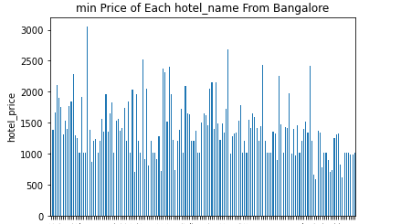
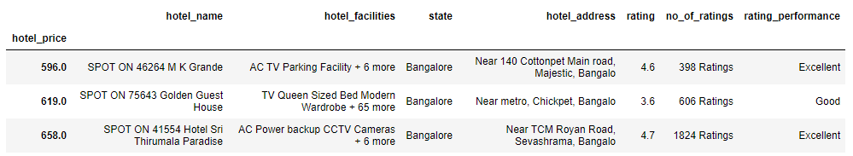
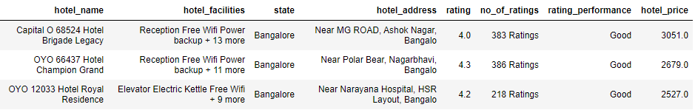
On This Chart Bangalore hotels Maximum & Minimum price
On This Chart All The hotels Minimum price is 596.00 INR or You Can See in The below List
On This Chart All The hotels Maximum price is 3051.00 INR or You Can See in The below List

Slide 20
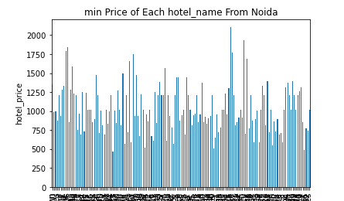
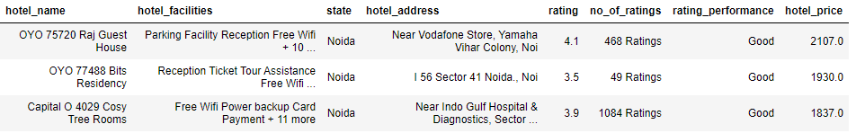
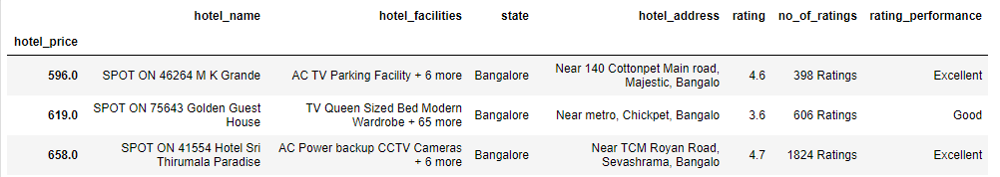
On This Chart Noida hotels Maximum & Minimum price
On This Chart All The hotels Maximum price is 2107.00 INR or You Can See in The below List
On This Chart All The hotels Minimum price is 596.00 INR or You Can See in The below List

Slide 21
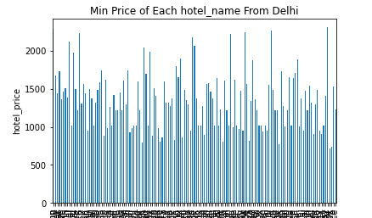
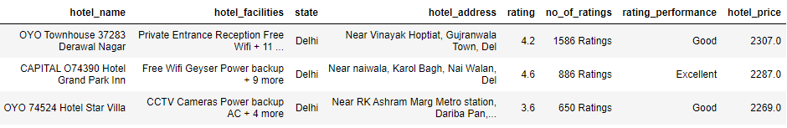
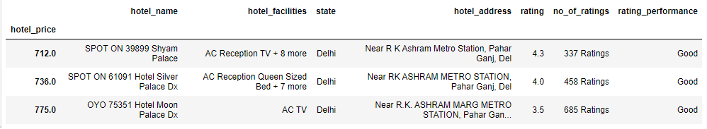
On This Chart Delhi hotels Maximum & Minimum price
On This Chart All The hotels Maximum price is 2,307.00 INR or You Can See in The below List
On This Chart All The hotels Minimum price is 712.00 INR or You Can See in The below List

Slide 22
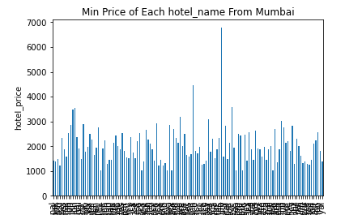
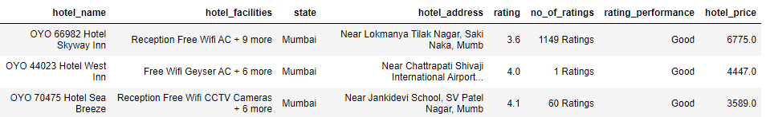
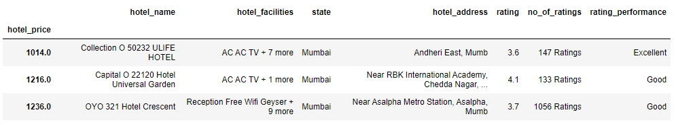
On This Chart Mumbai hotels Maximum & Minimum price
On This Chart All The hotels Maximum price is 6,775.00 INR or You Can See in The below List
On This Chart All The hotels Minimum price is 1,014.00 INR or You Can See in The below List

Slide 23
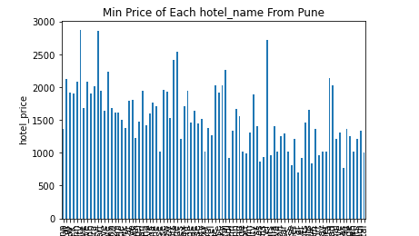
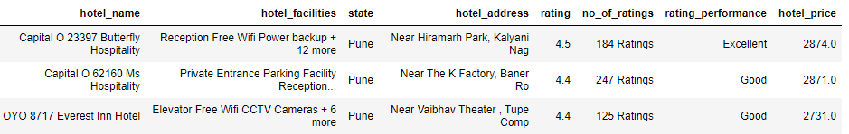
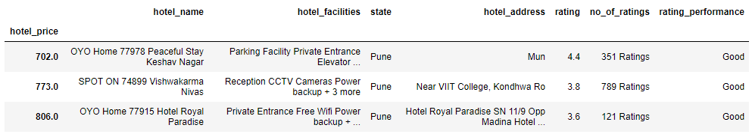
On This Chart Pune hotels Maximum & Minimum price
On This Chart All The hotels Maximum price is 2,874.00 INR or You Can See in The below List
On This Chart All The hotels Minimum price is 702.00 INR or You Can See in The below List

Slide 24
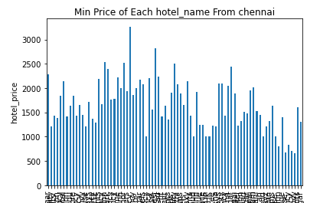
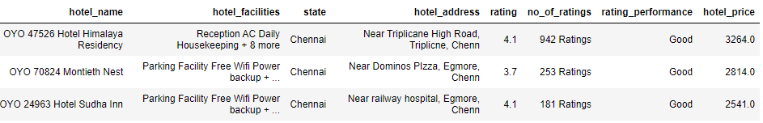
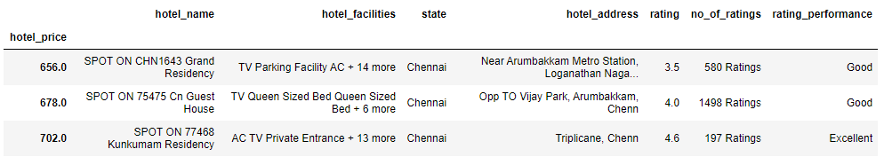
On This Chart Chennai hotels Maximum & Minimum price
On This Chart All The hotels Maximum price is 3,264.00 INR or You Can See in The below List
On This Chart All The hotels Minimum price is 656.00 INR or You Can See in The below List

Slide 25
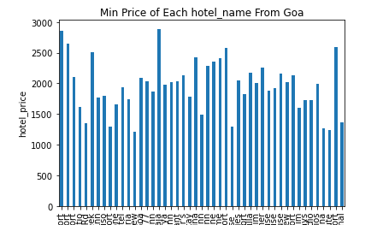
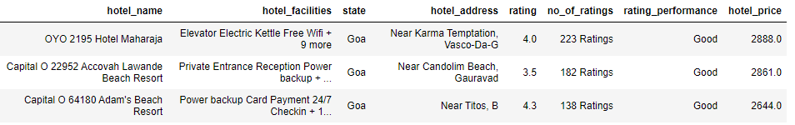
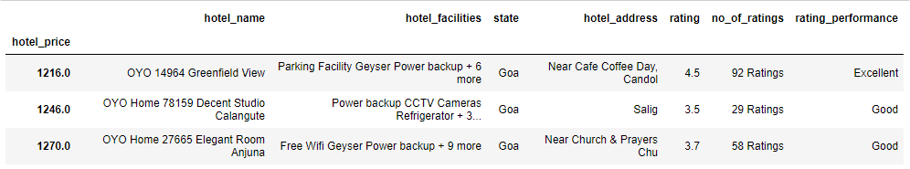
On This Chart Goa hotels Maximum & Minimum price
On This Chart All The hotels Maximum price is 2,888.00 INR or You Can See in The below List
On This Chart All The hotels Minimum price is 1,216.00 INR or You Can See in The below List

Slide 26
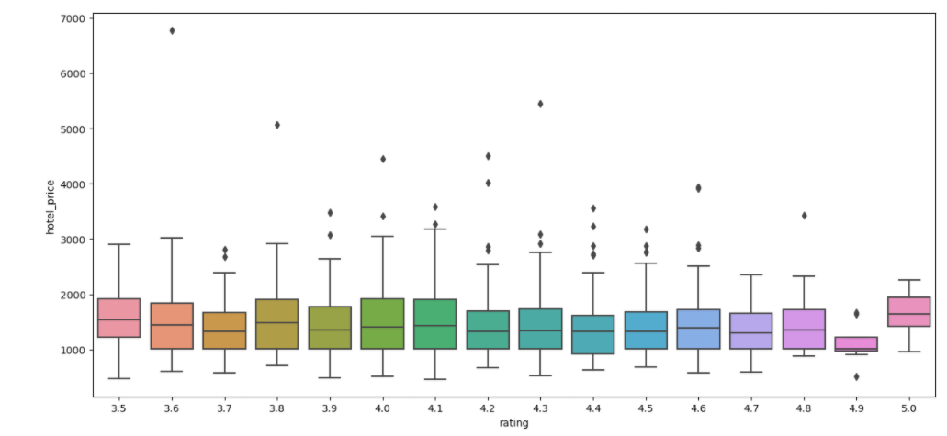
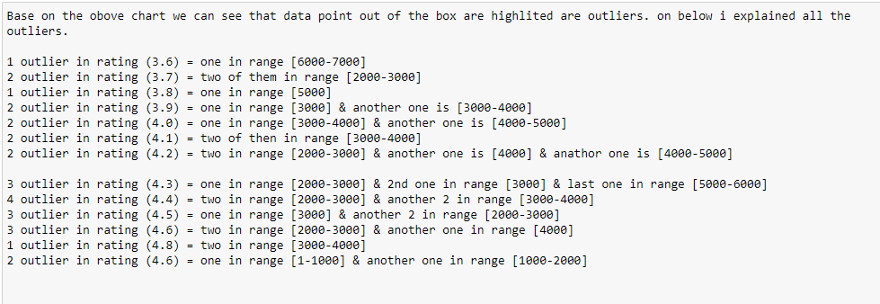
On This chart we can see that data point out of the box are highlighted are outliers. on below i explained all the outliers.

Slide 27
THANKS FOR YOUR
ATTENTON

